Slide 1
Rapid Antigen Test (RAT) Tracker TEAM 5

Slide 2


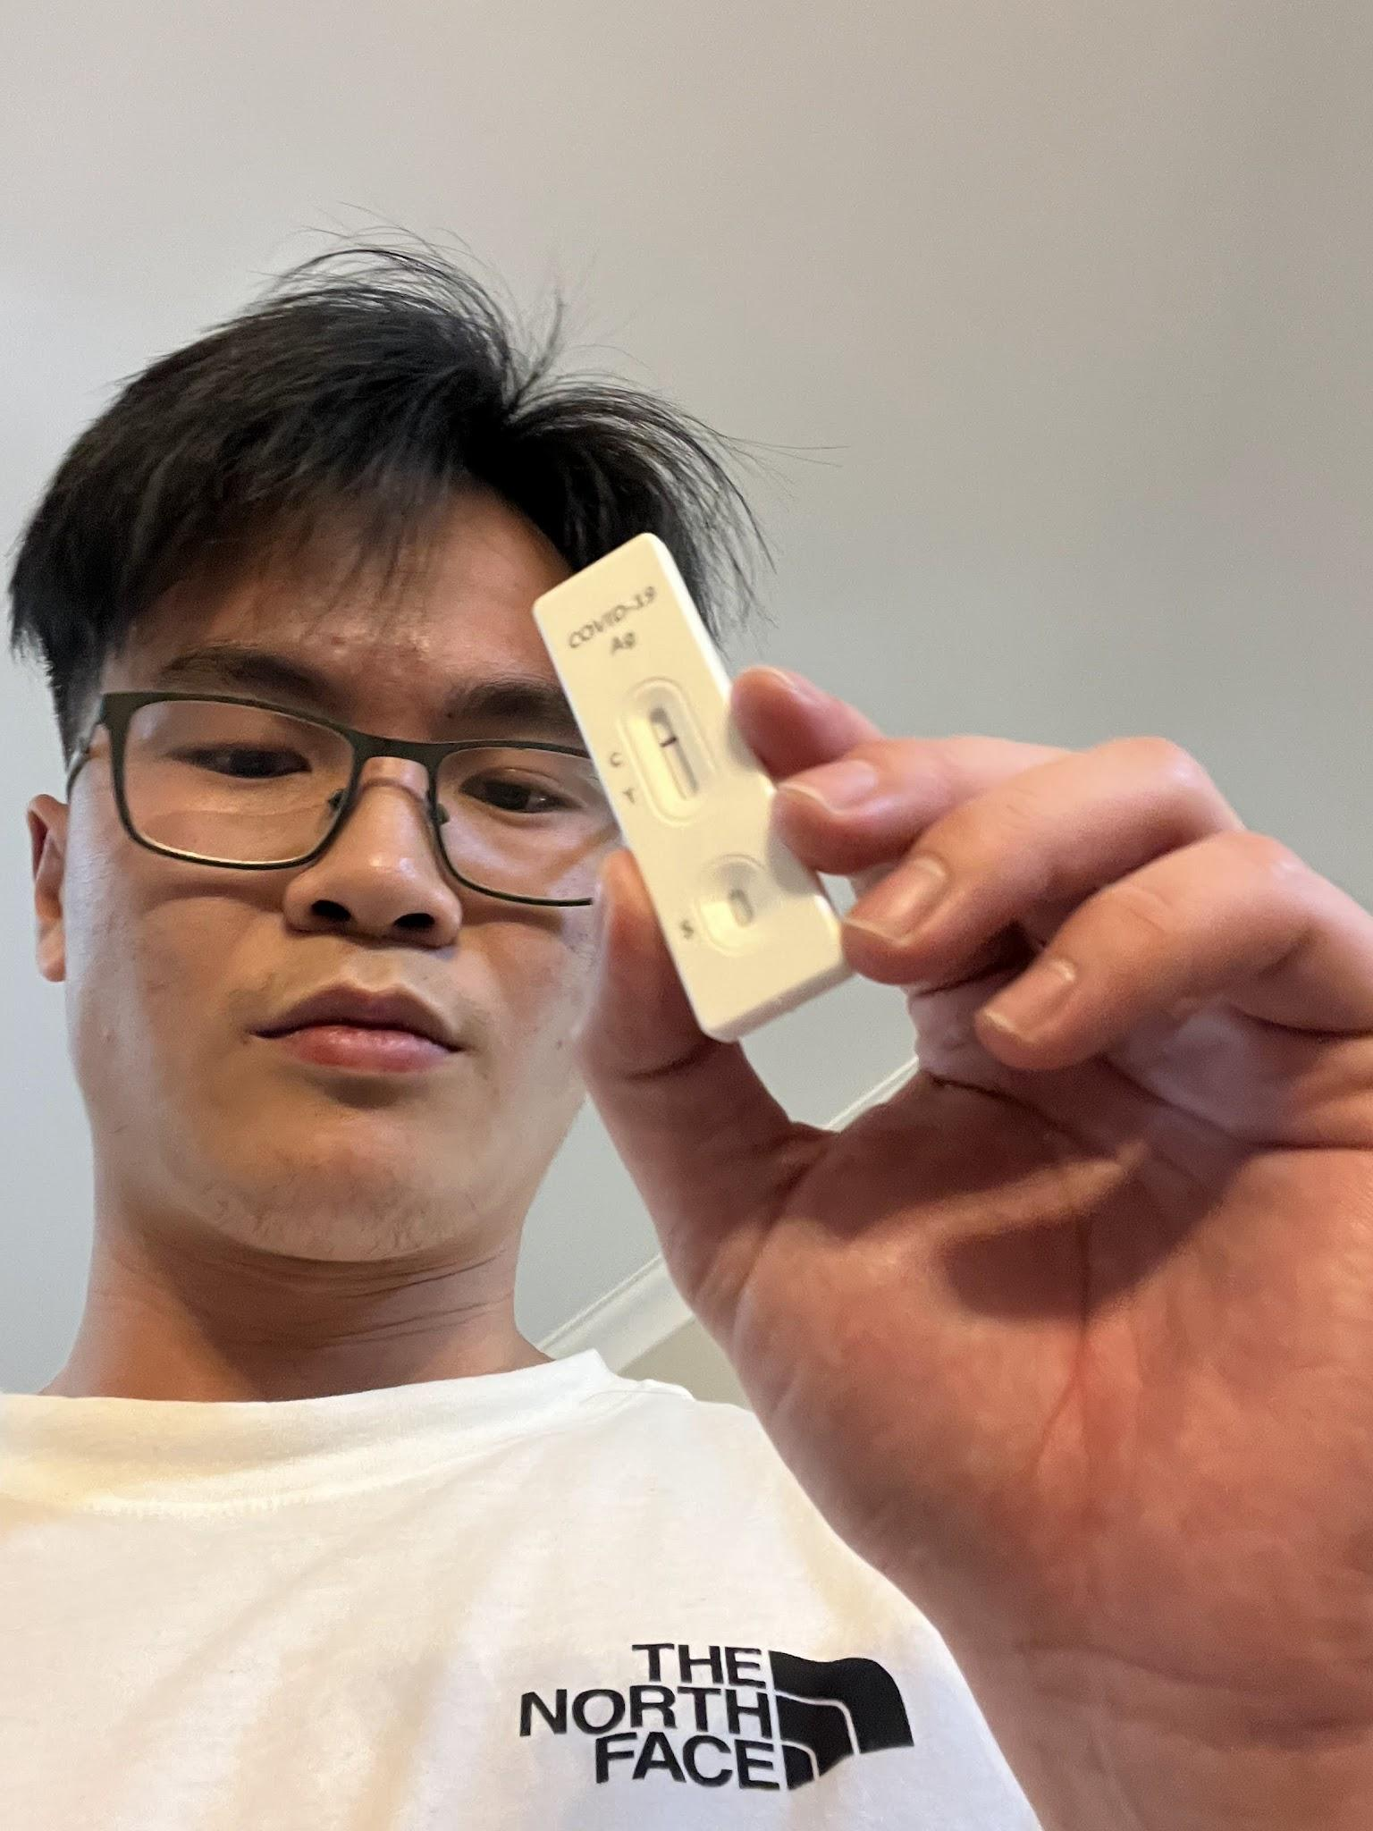




Team
Geraldine Ler
Lara Yousif
Joel Huang
Joseph Lin
Kellen Liew
Kush Shrestha
Yeliz Yakar
Machine Learning
Front End
Fullstack
Automation/ AWS
Fullstack/ Serverless
Prototyping &
Project Management
Front End
Mentors:
Andrew Gorecki Asfiya Memon Carmen Lee

Slide 3


1. Problem Statement
We need a more efficient solution for tracking rapid antigen tests for workers which in effect will improve the current manual process.
Disadvantages:
Cost
Increase amount of workers
Time
Increase wait time

Slide 4
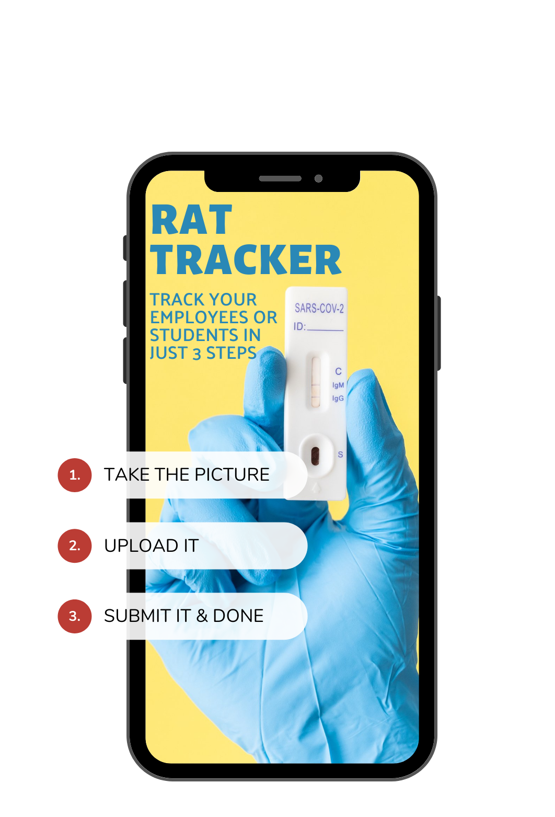


Slide 5


2. Use Case and Solution Requirements
Requirements:
Take a picture of your RAT
Upload the evidence
Benefits:
Simple
Effortless
Time Saved
Requirements:
Gets notified of positive cases
Clear evidence of compliance
Benefits:
Concise
Informative

Slide 6

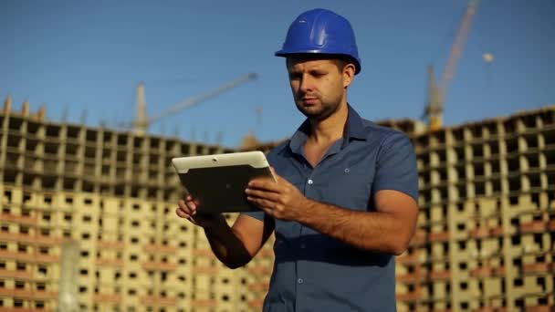
3. Demo Time!
Employees
Quick and Remote covid reporting
Employers
Evaluation at a glance with powerful follow-up management tools
Everyone
We can focus on the important things!
Please enjoy the demonstration! As you watch, let’s observe the key points of value for our stakeholders.

Slide 7
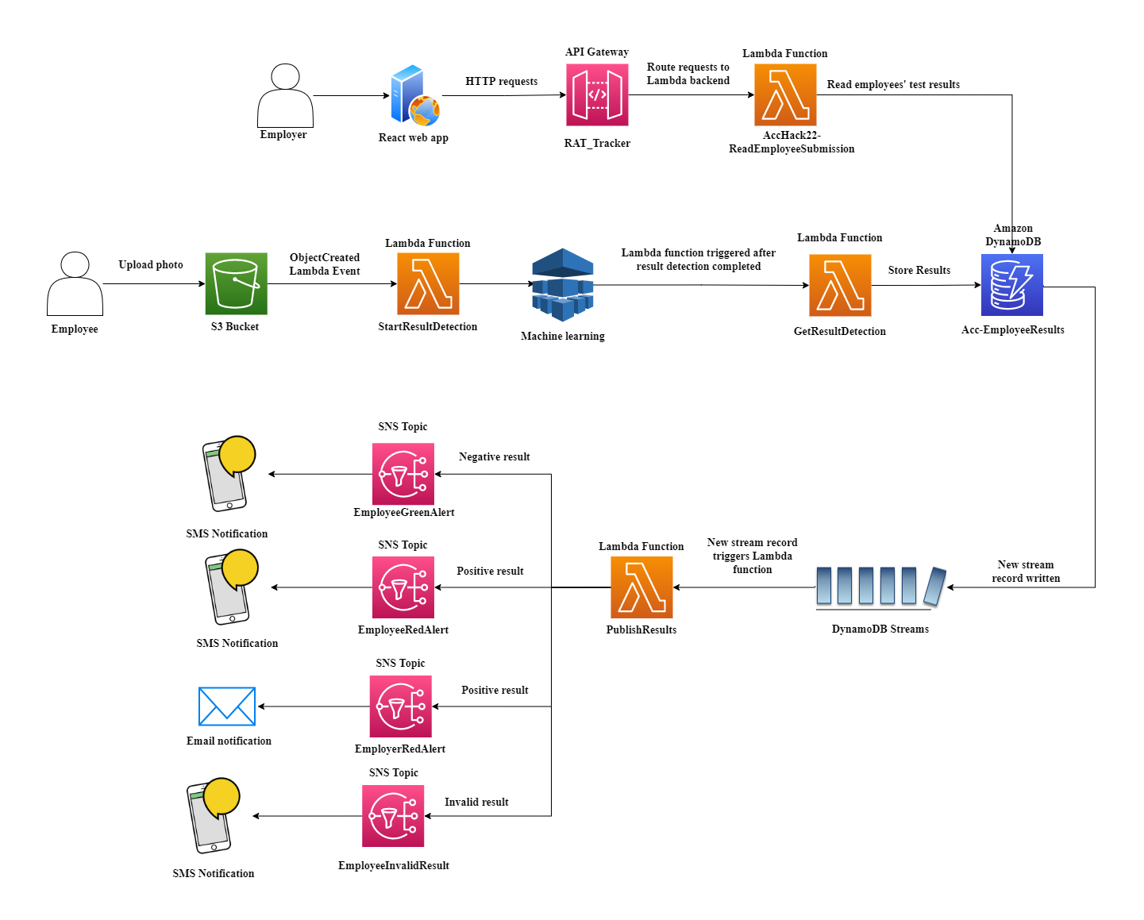
4. Solution Architecture
Fig: Solution Architecture Diagram

Slide 8
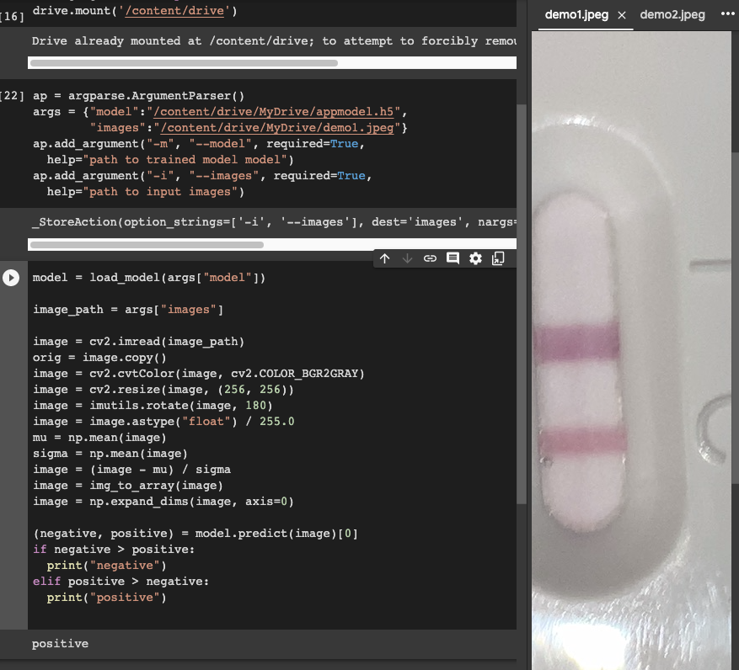
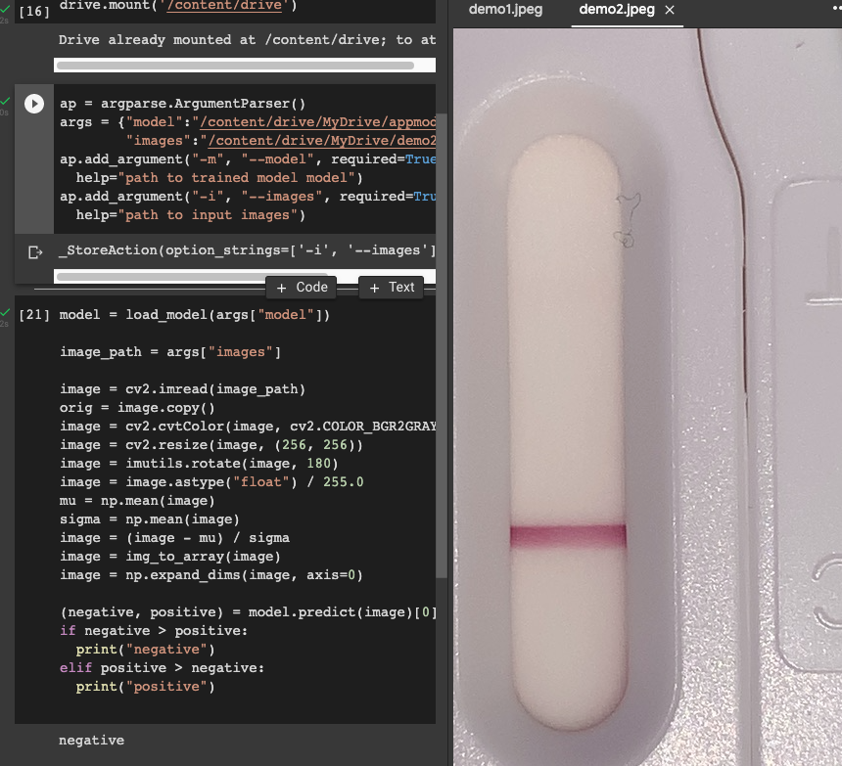
5. Future Improvements
Improve UI
Incorporate machine learning component to web app
Mendels et al., PNAS, 2021 - public license

Slide 9
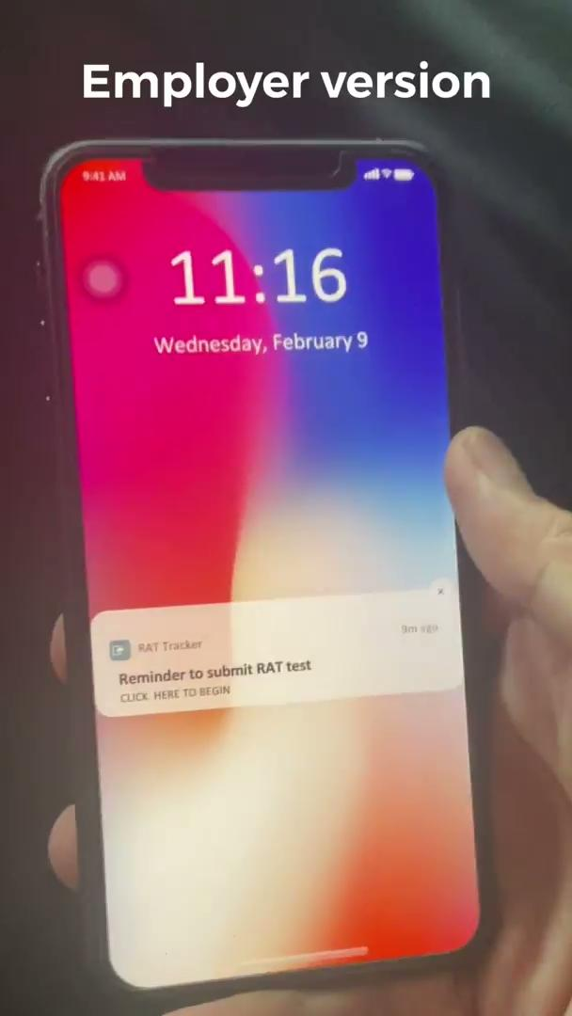
6. Development Journey and Process

Slide 10

7. Lessons Learnt

Slide 11
Thank you!

